Slide 1
ORACLES forecasting Briefing Meteorology
Briefing on 07-09-2016 8am
Forecasting for flight 8/11-09-2016

Slide 2
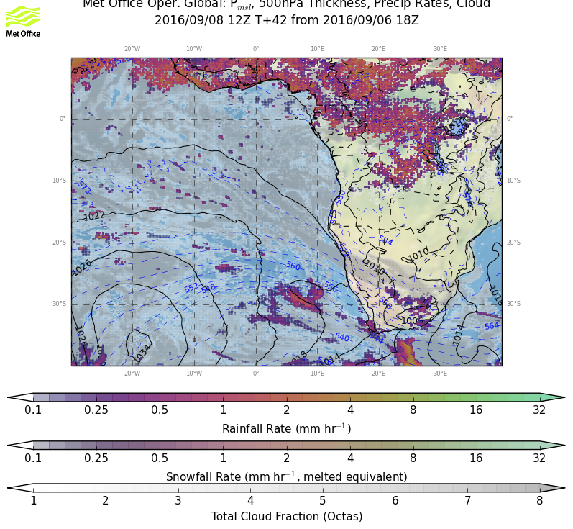
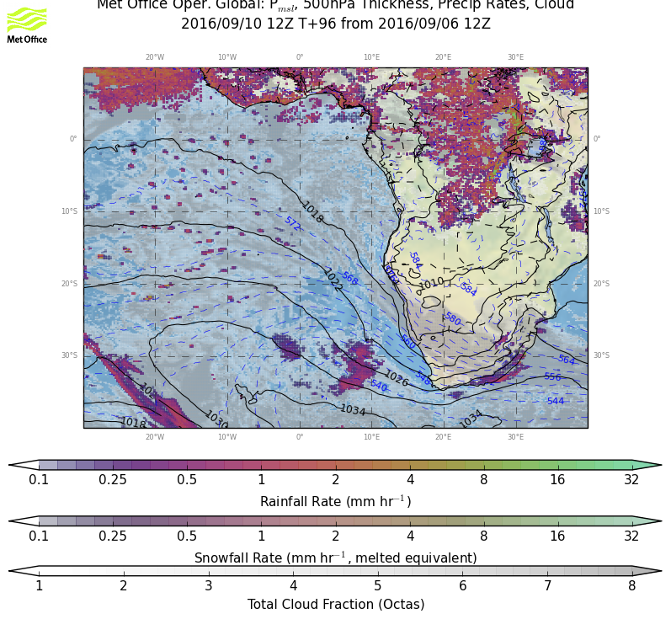
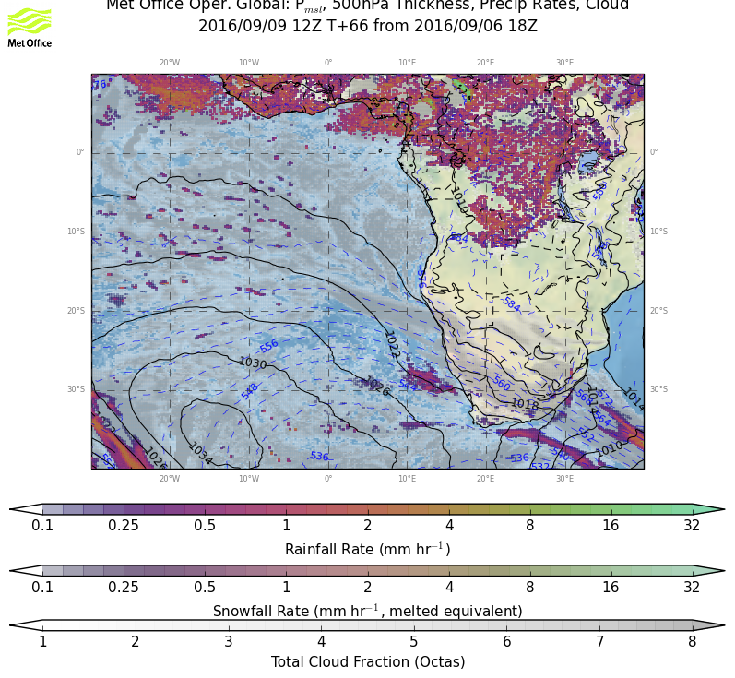
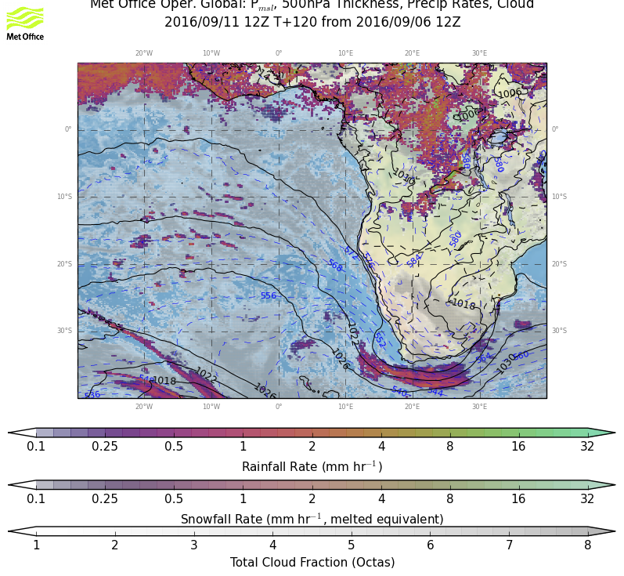
9/8 THU, 12Z
Weather overview:
P msl
Cloud cover
Precip
9/10 SAT, 12Z
RF
OF
9/9 FRI, 12Z
9/11 SUN, 12Z

Slide 3
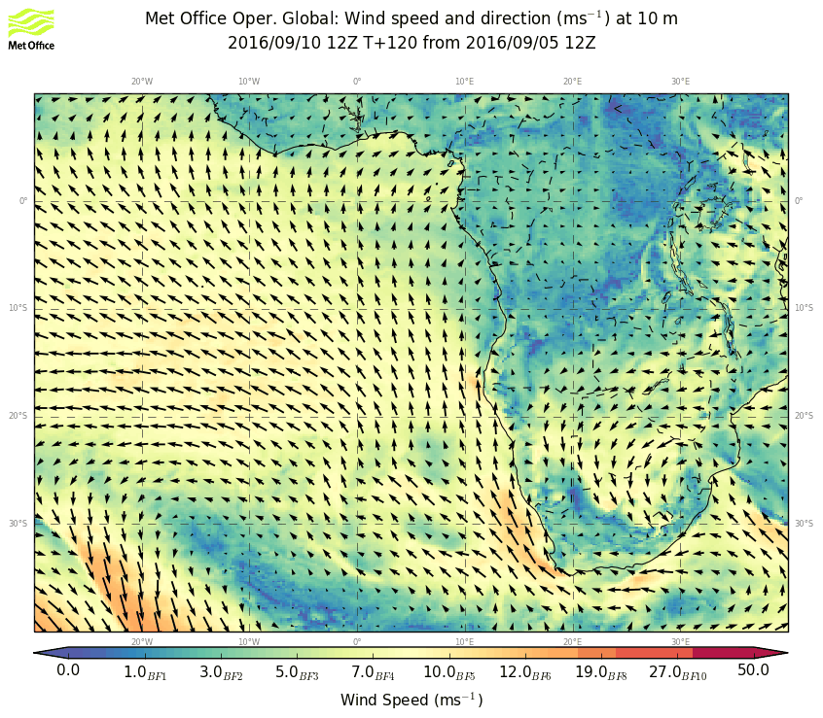
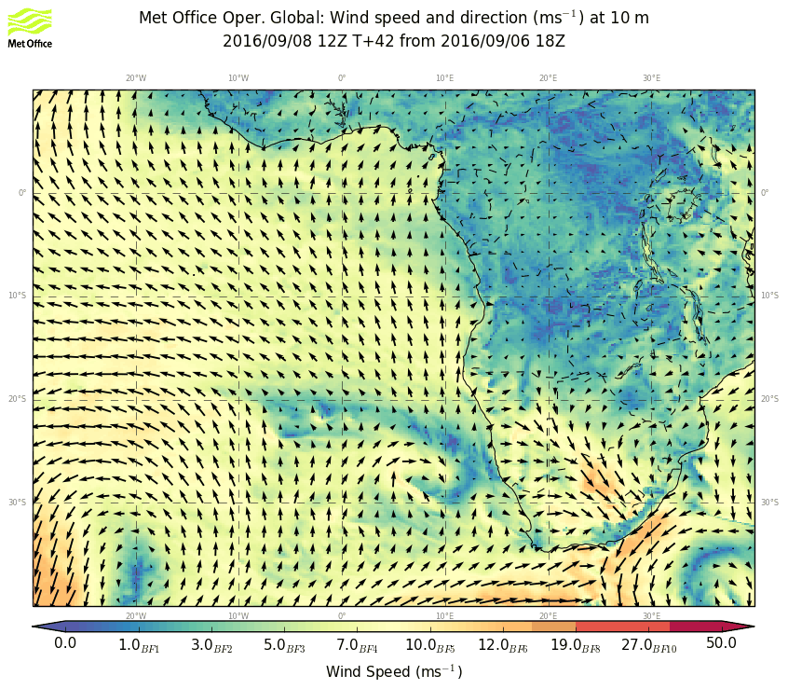
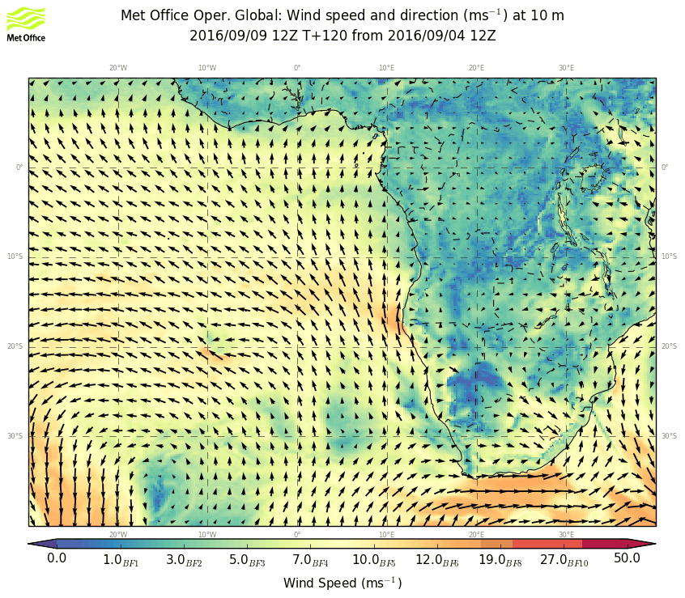
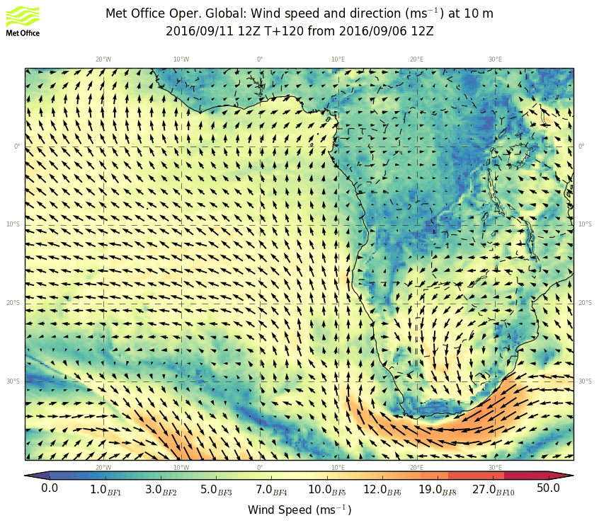
9/8 THU, 12Z
Wind 10m
9/10 SAT, 12Z
RF
OF
9/9 FRI, 12Z
9/11 SUN, 12Z

Slide 4
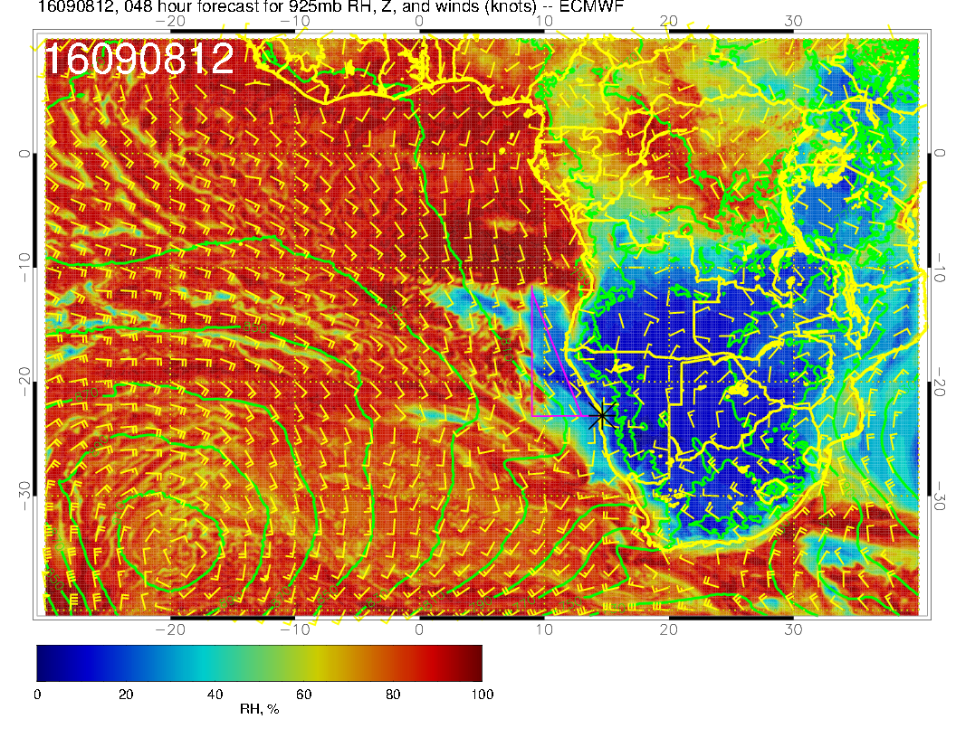
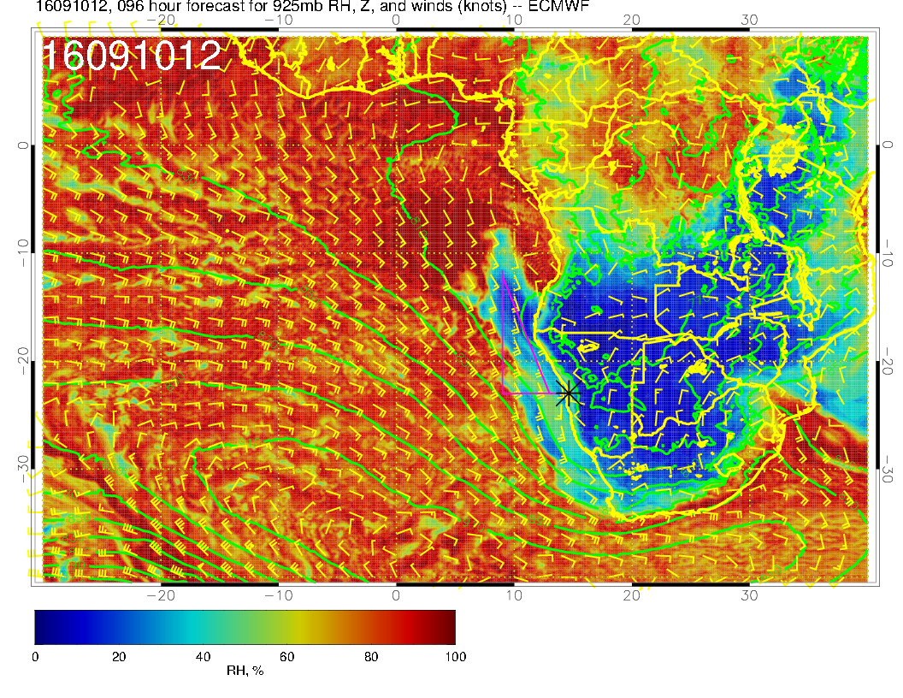
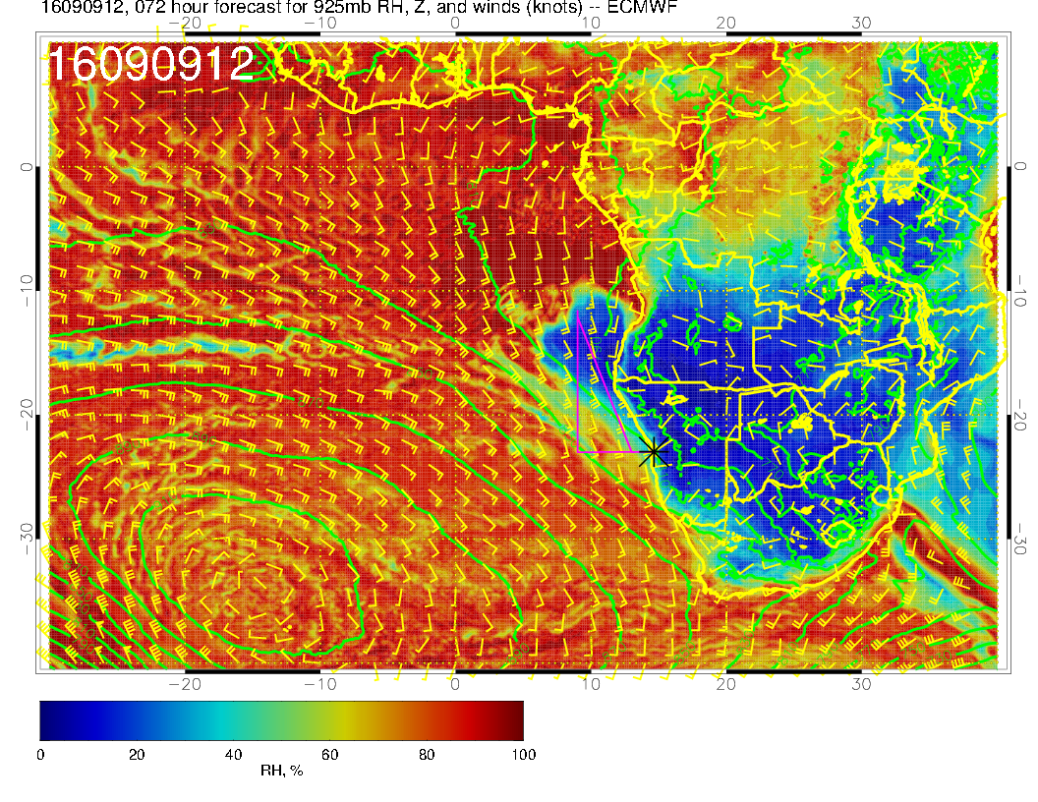
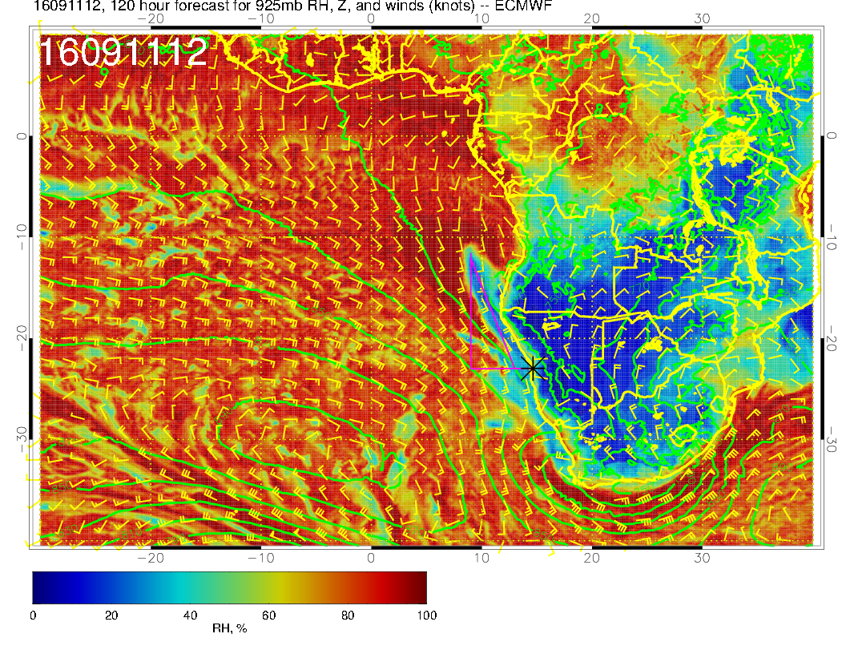
9/8 THU, 12Z
Wind 925hPa
9/10 SAT, 12Z
RF
OF
9/9 FRI, 12Z
9/11 SUN, 12Z

Slide 5
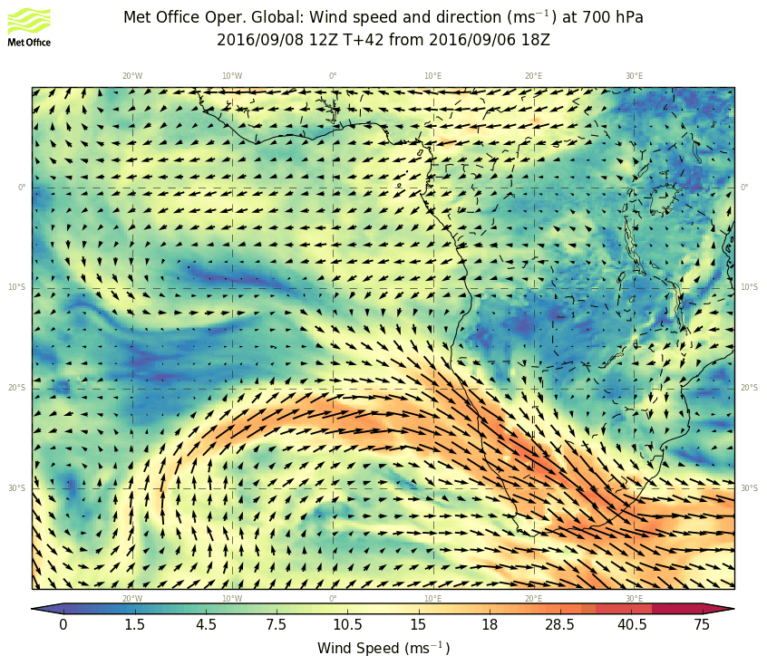
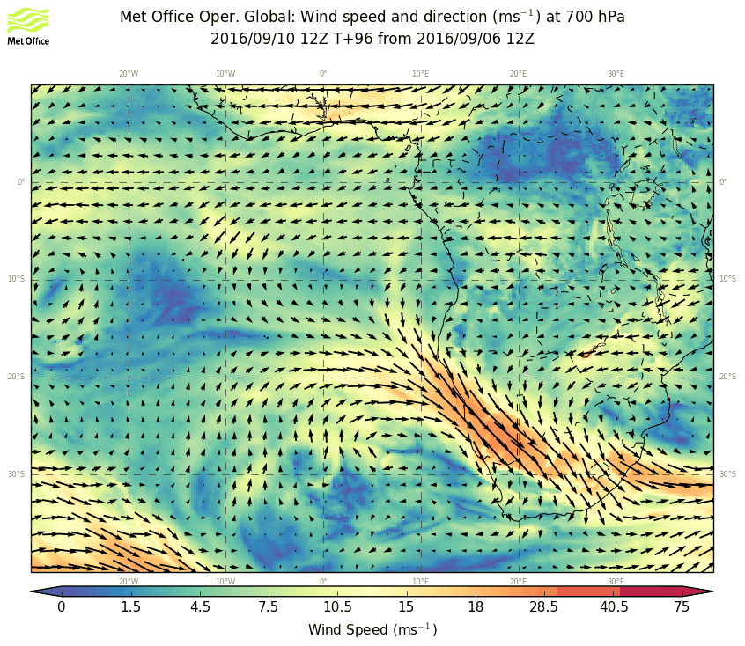
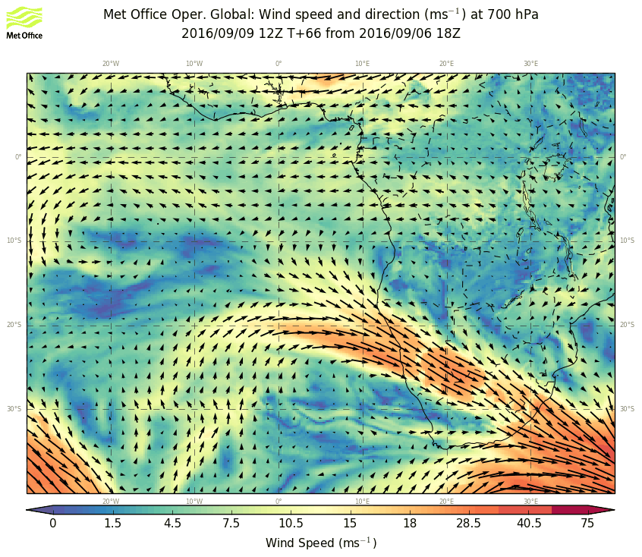
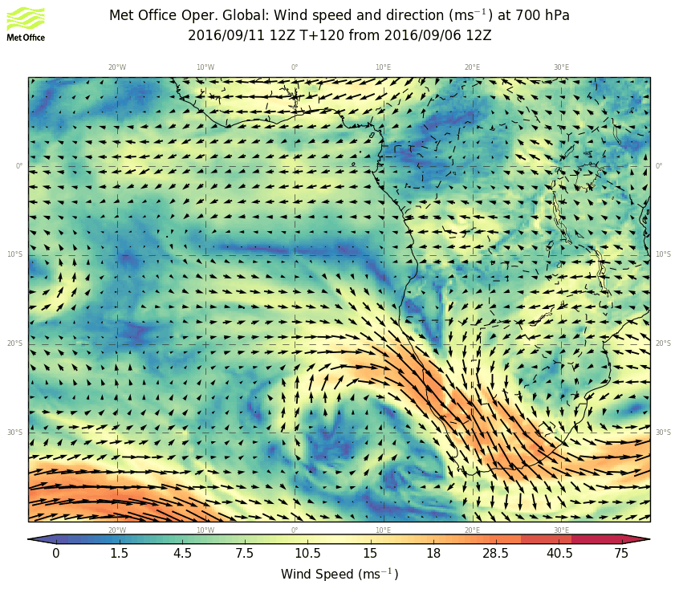
9/8 THU, 12Z
Wind 700 hPa
9/10 SAT, 12Z
RF
OF
9/9 FRI, 12Z
9/11 SUN, 12Z

Slide 6
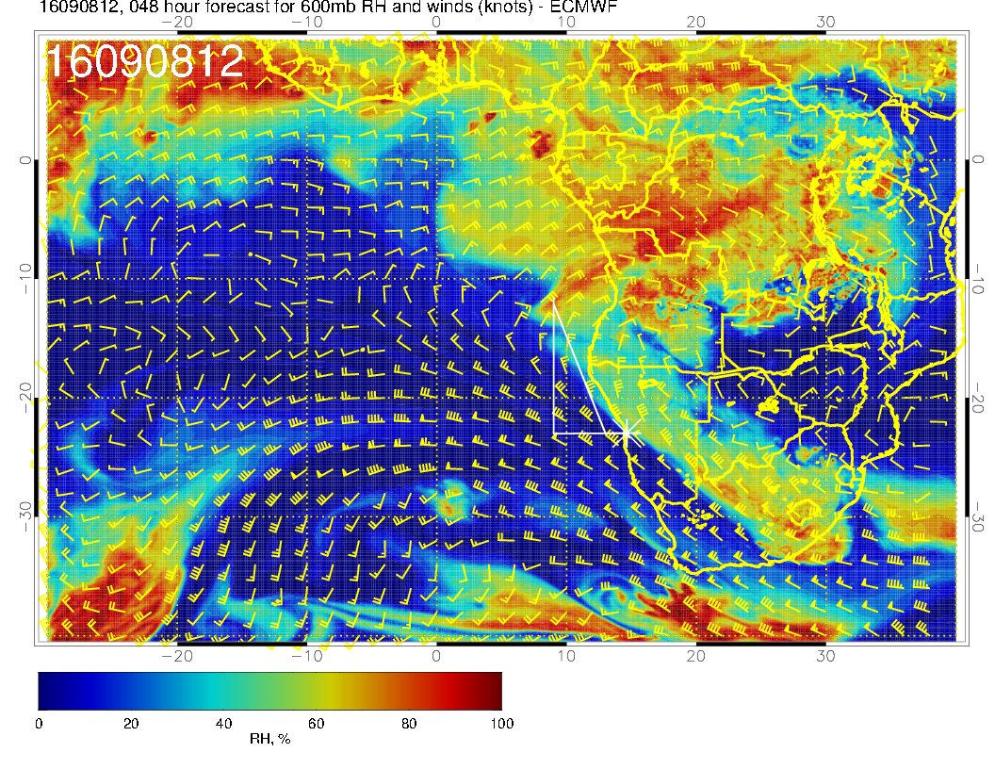
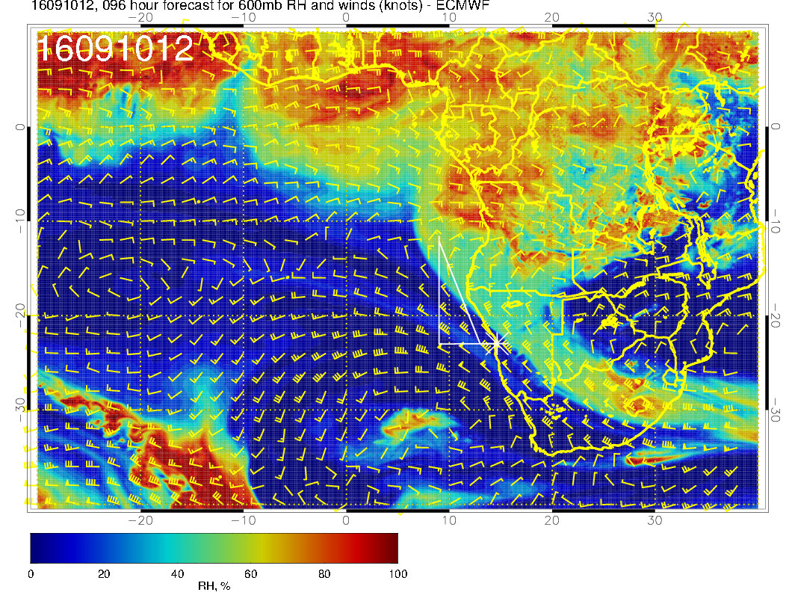
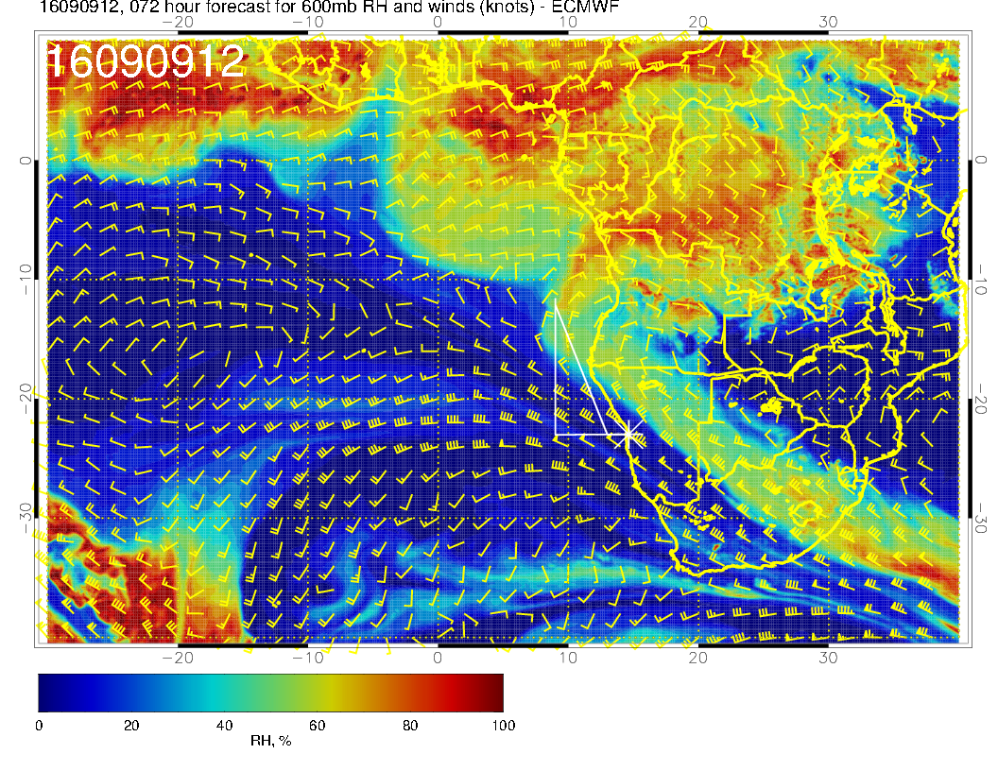
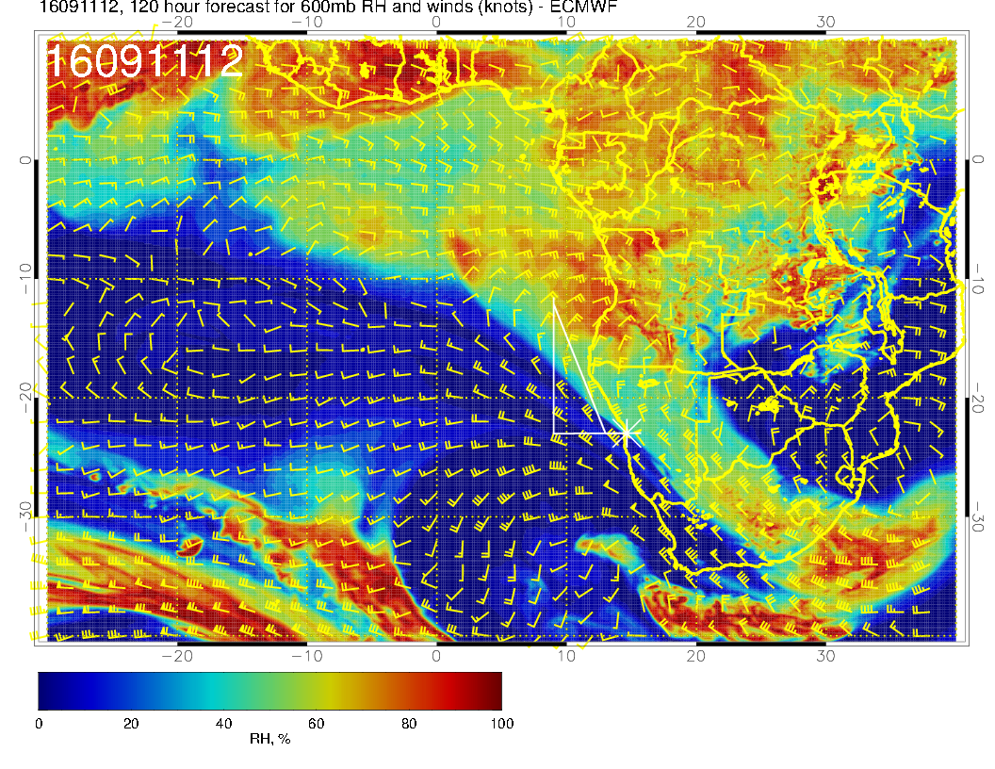
9/8 THU, 12Z
Wind 600
9/10 SAT, 12Z
RF
OF
9/9 FRI, 12Z
9/11 SUN, 12Z

Slide 7
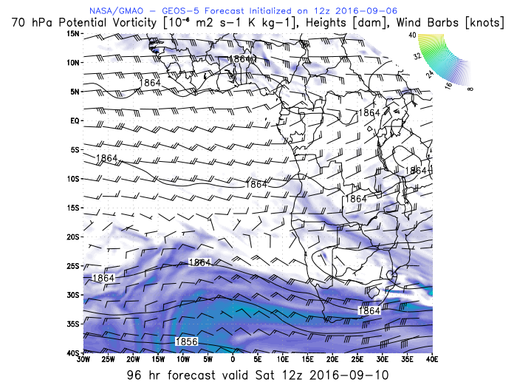
WIND 70 hPa
ER-2 alt
9/10 SAT, 12Z
OF

Slide 8
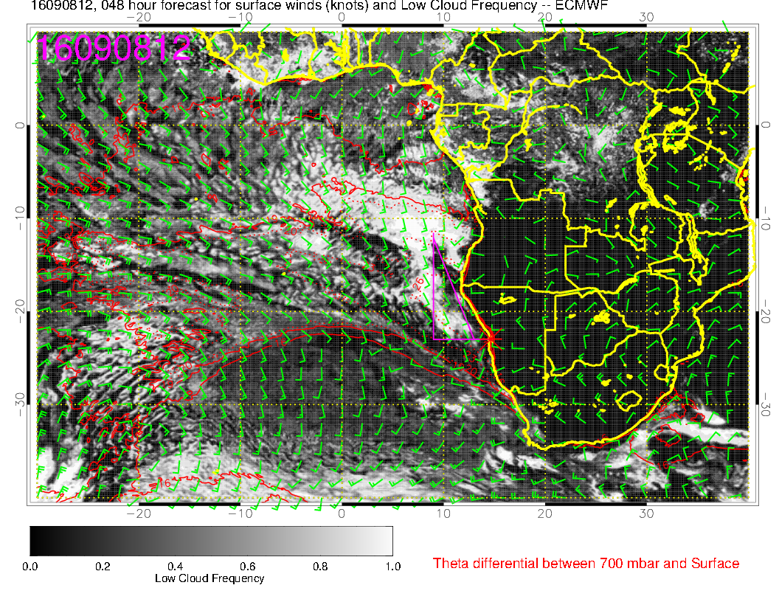
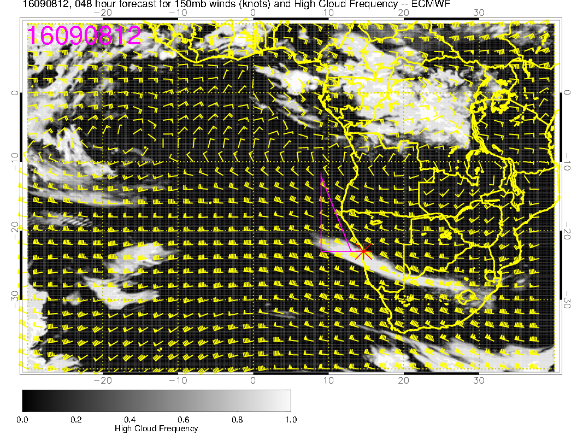
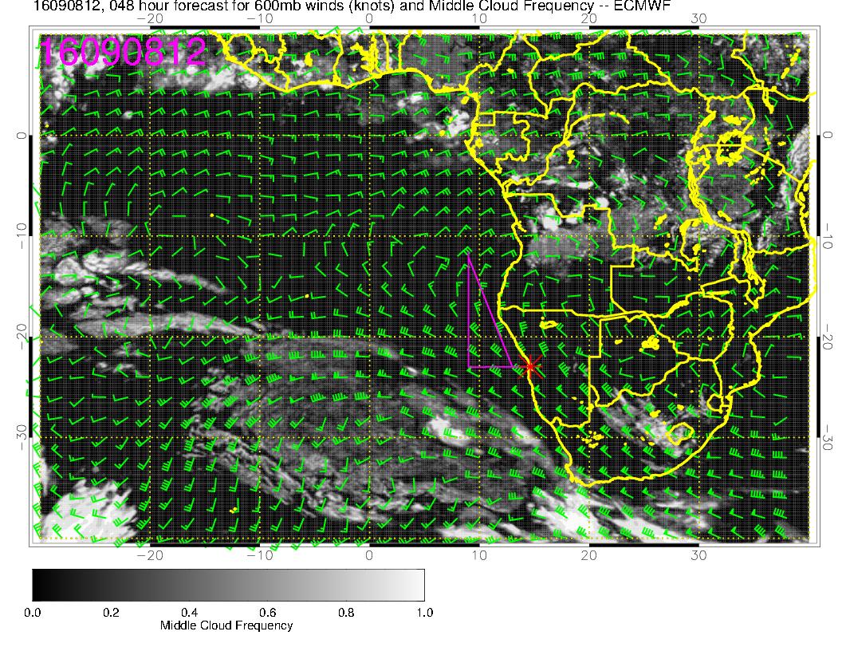
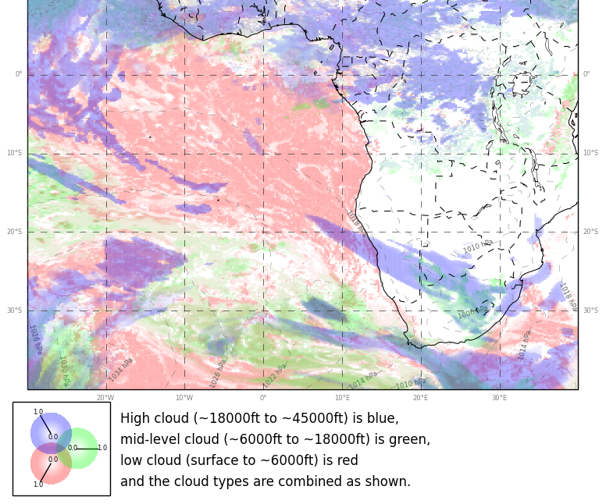
9/8 THU, 12Z
low
high
RF
mid

Slide 9
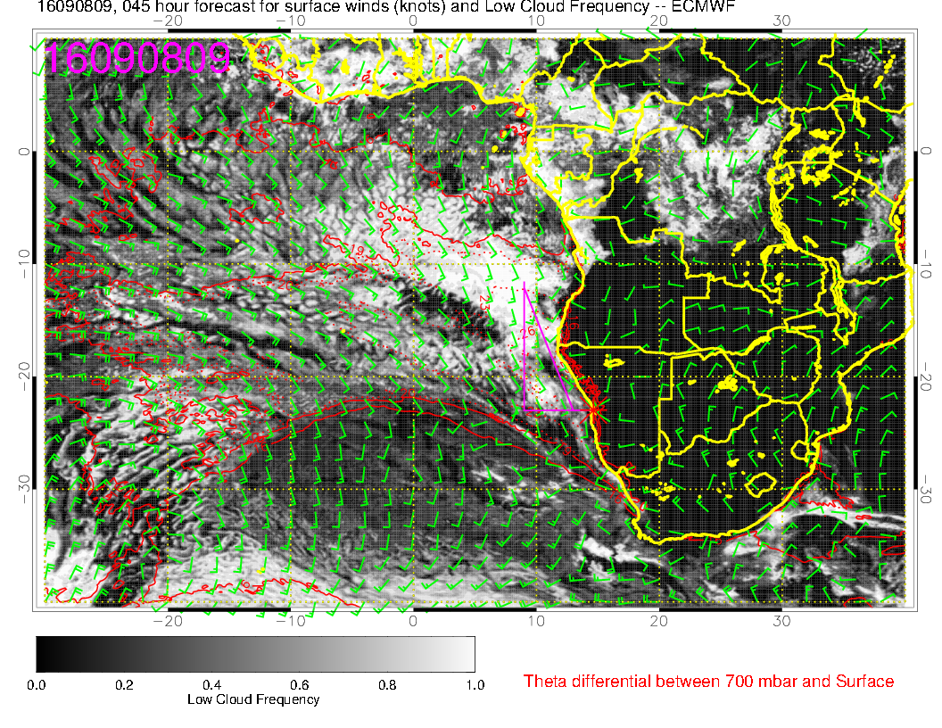
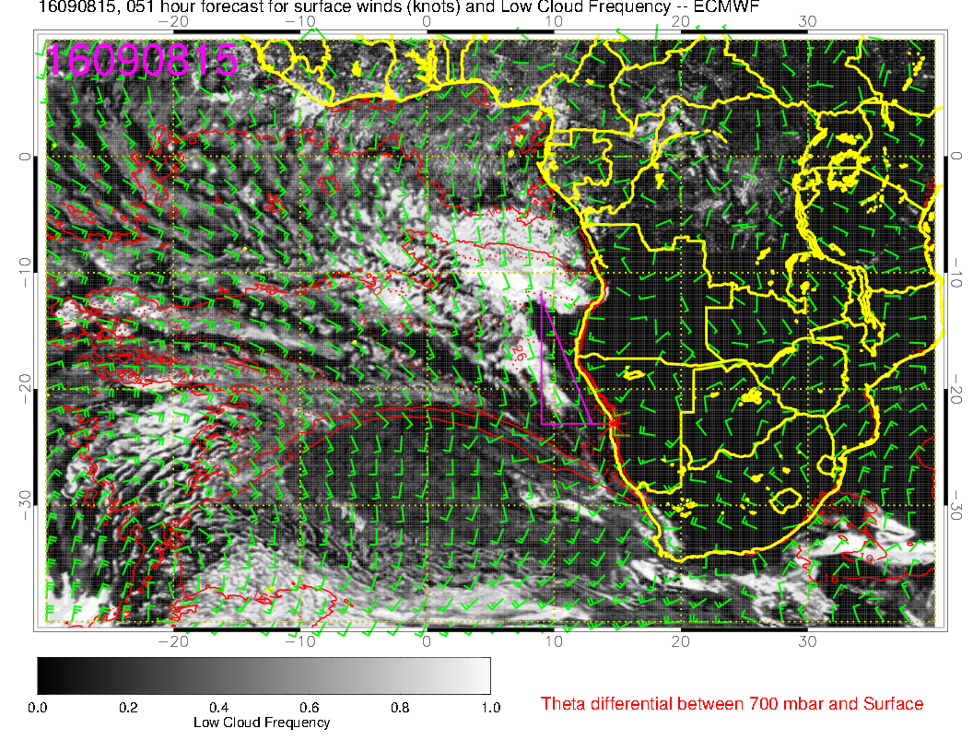
RF
9/8 THU, 9Z 15Z
11am – 5pm

Slide 10
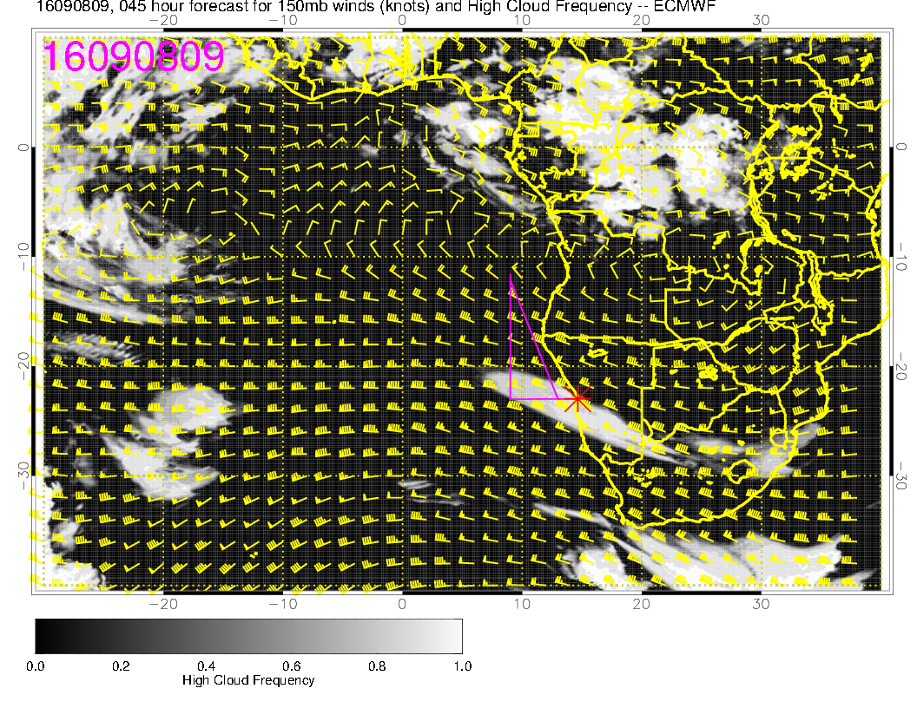
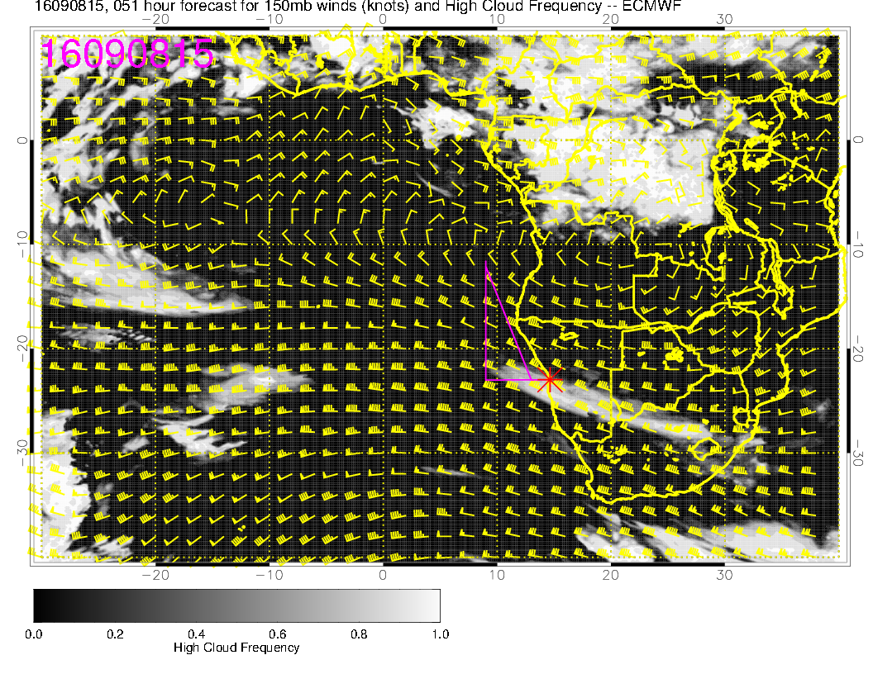
RF
9/8 THU, 9Z 15Z
high

Slide 11
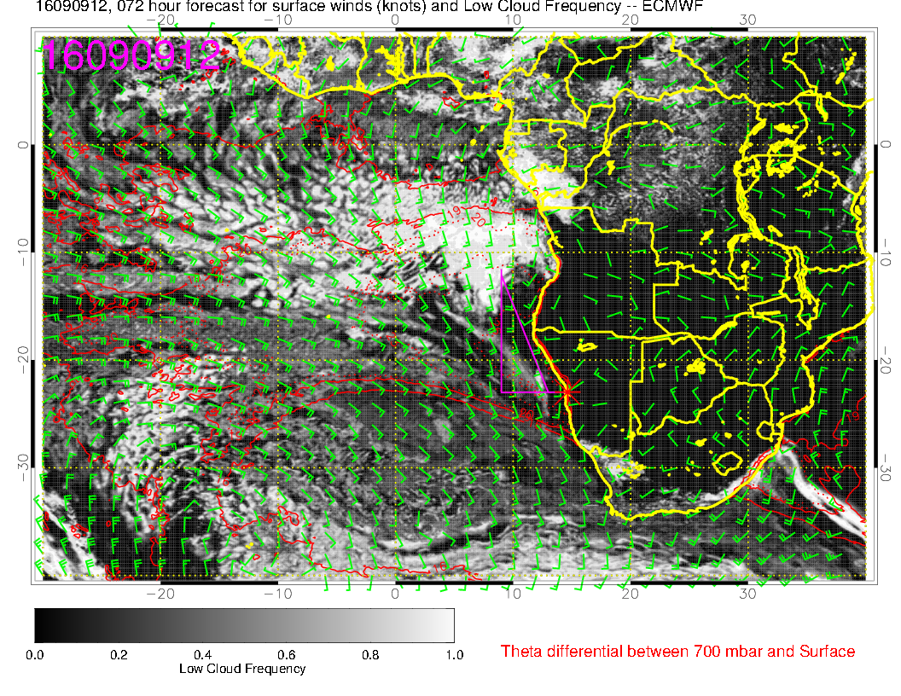
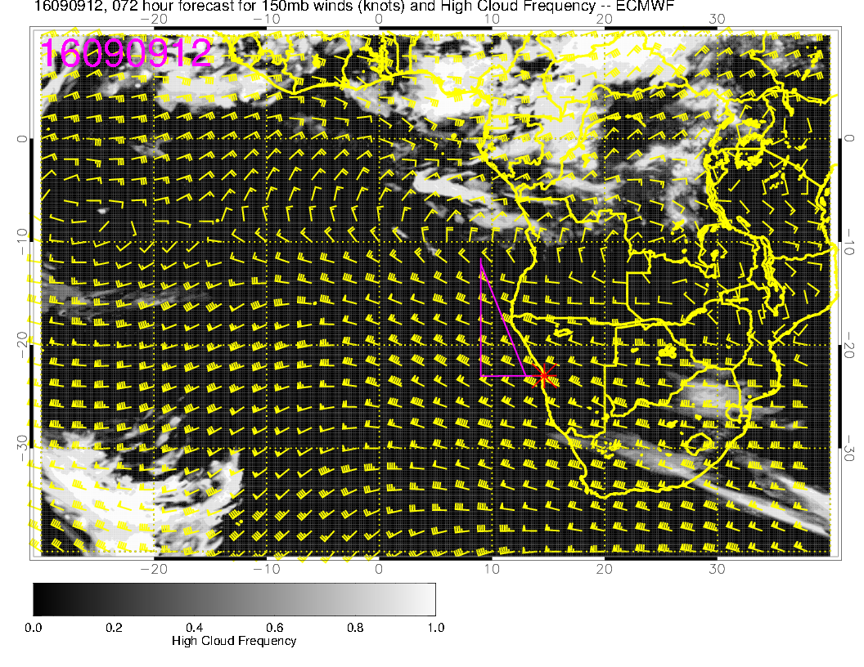
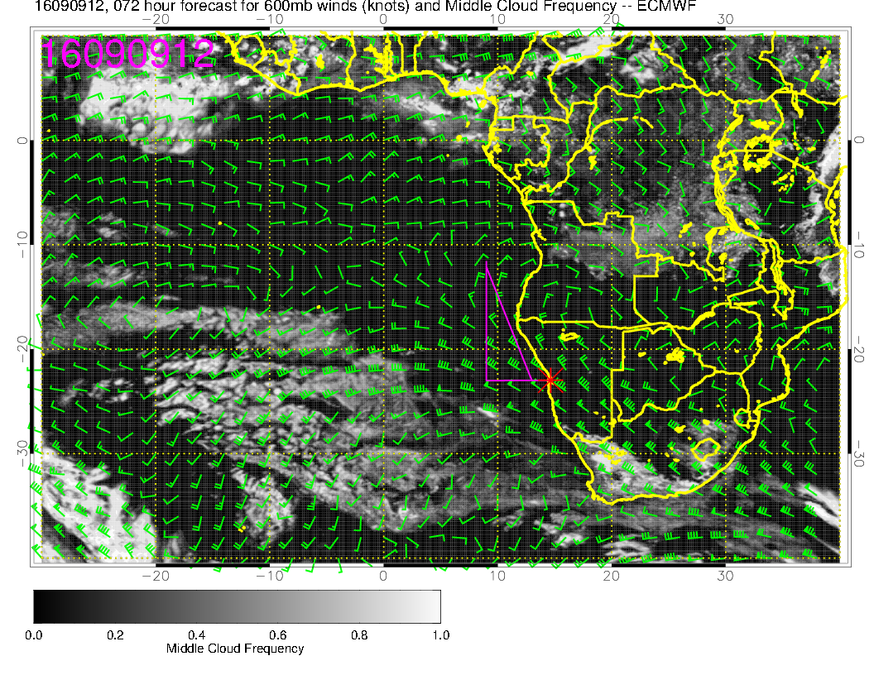
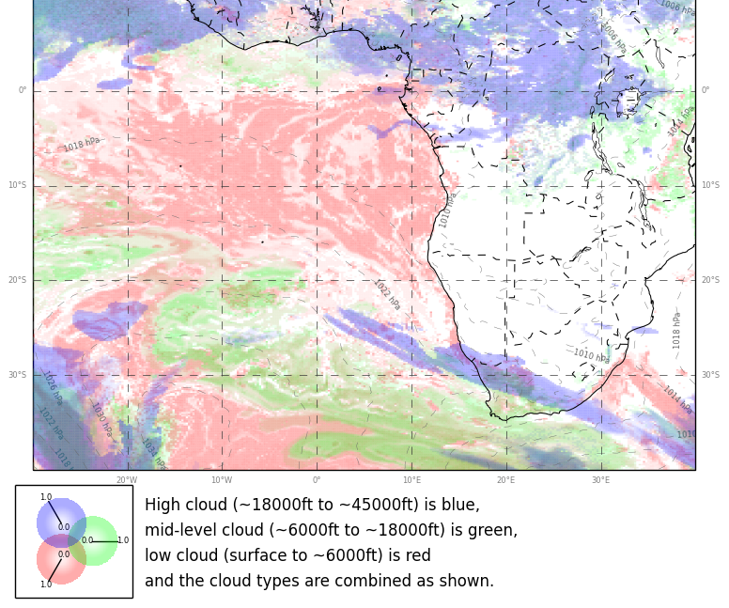
9/9 FRI, 12Z
low
high
mid

Slide 12
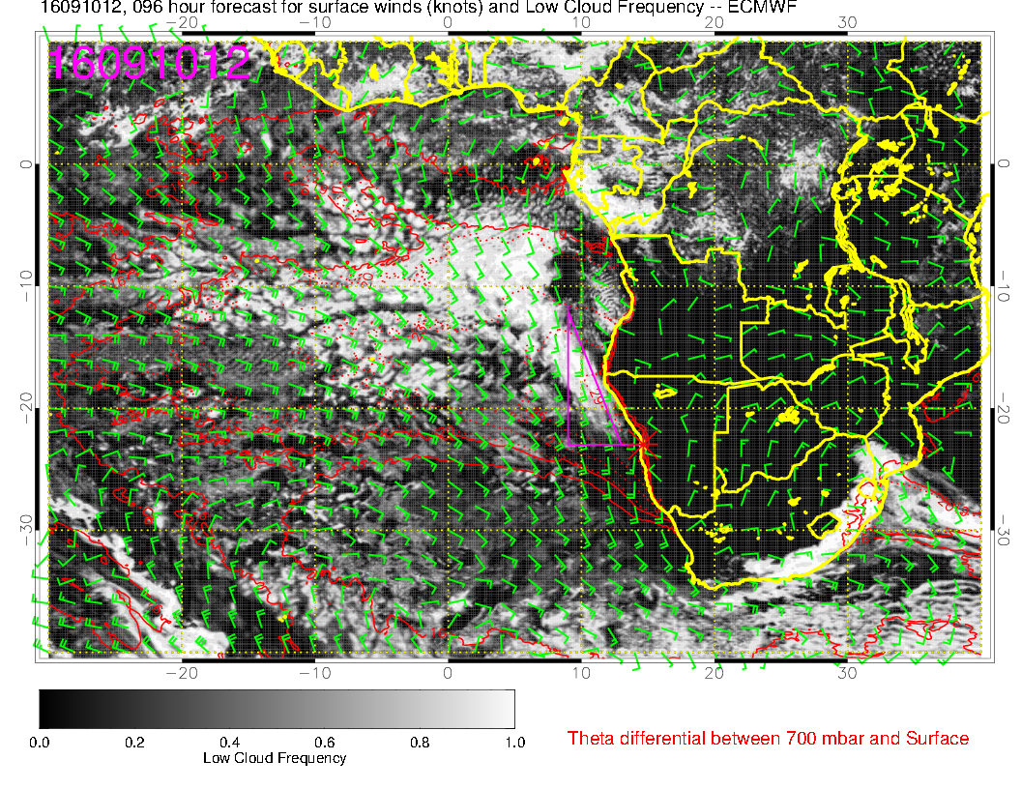
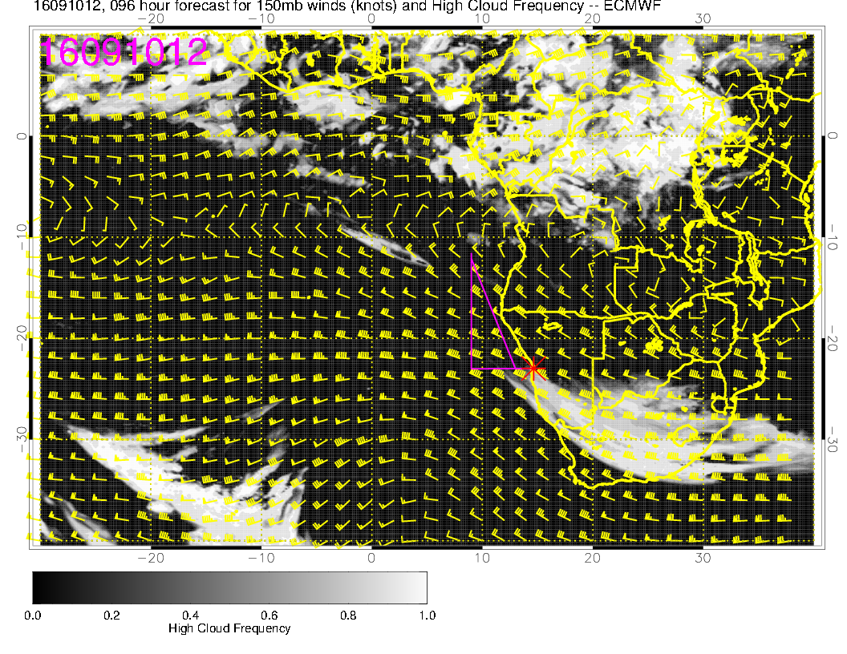
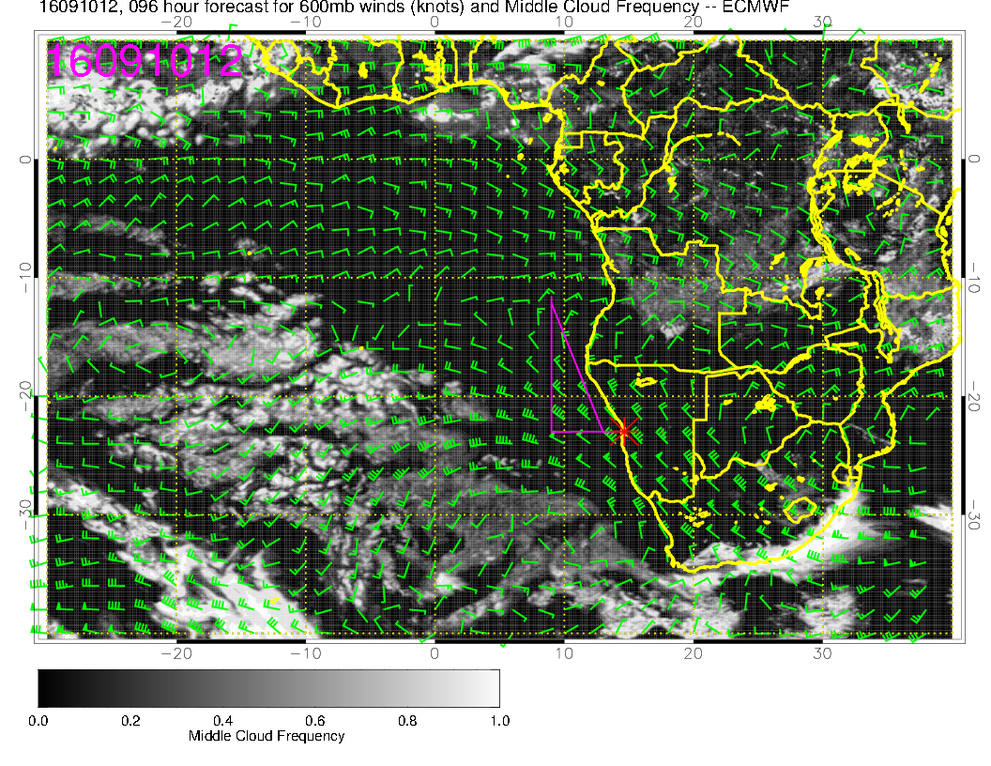
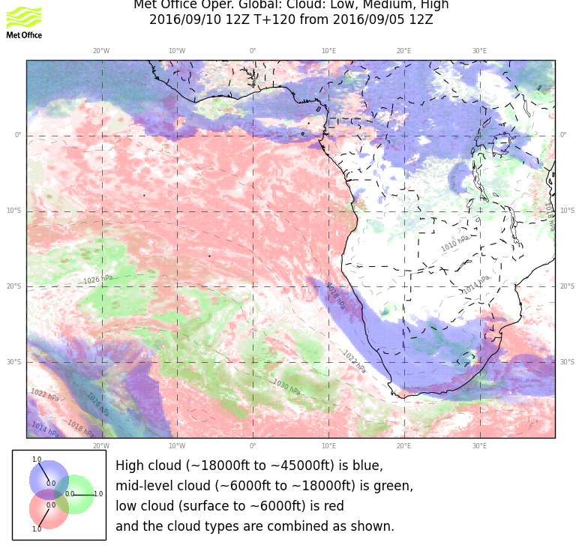
low
9/10 SAT, 12Z
high
TOF
mid

Slide 13
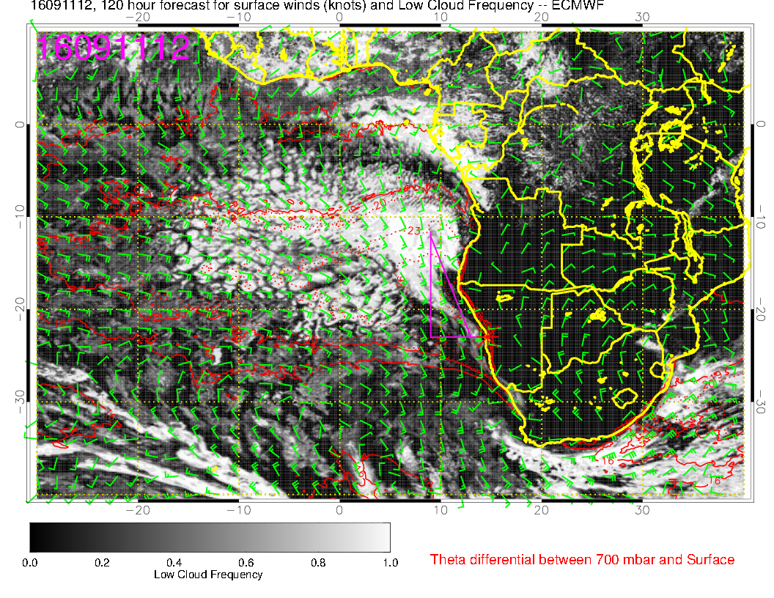
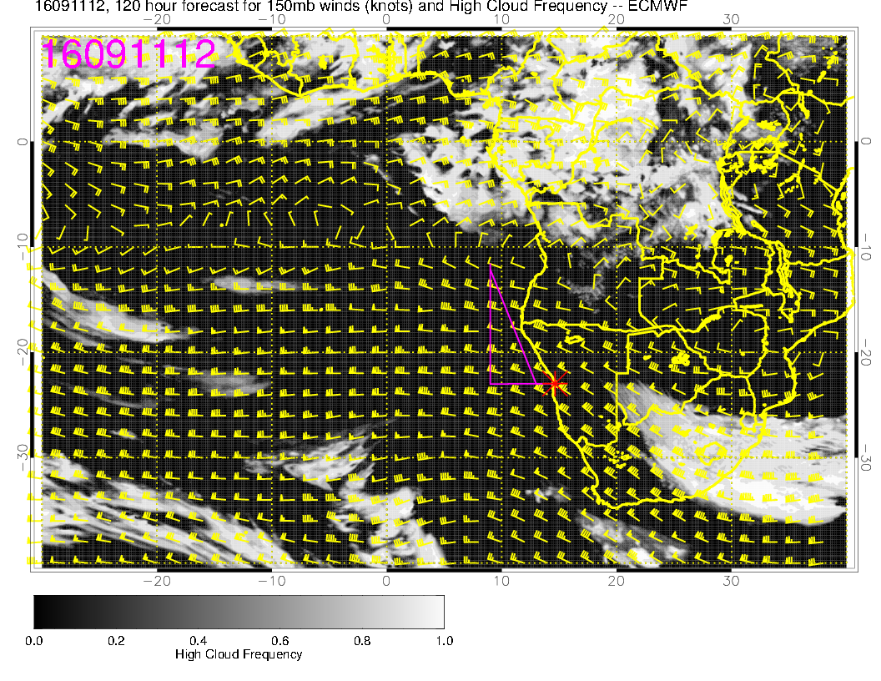
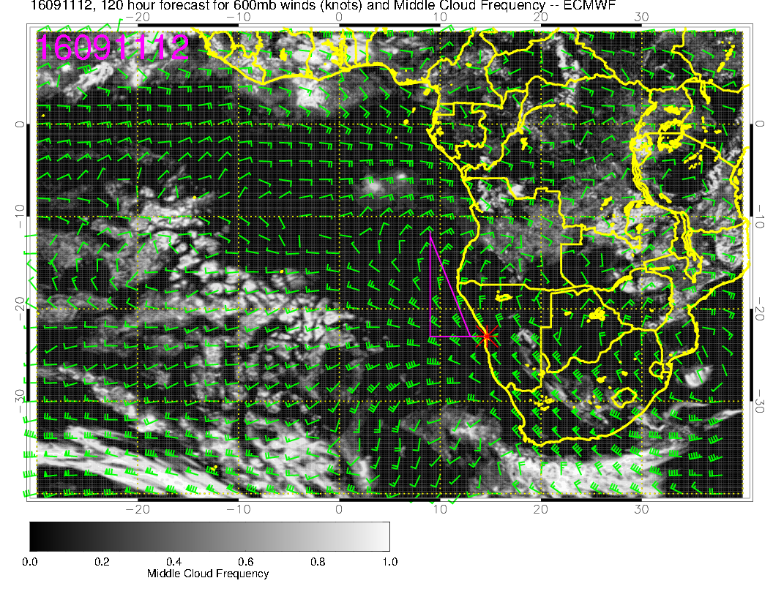
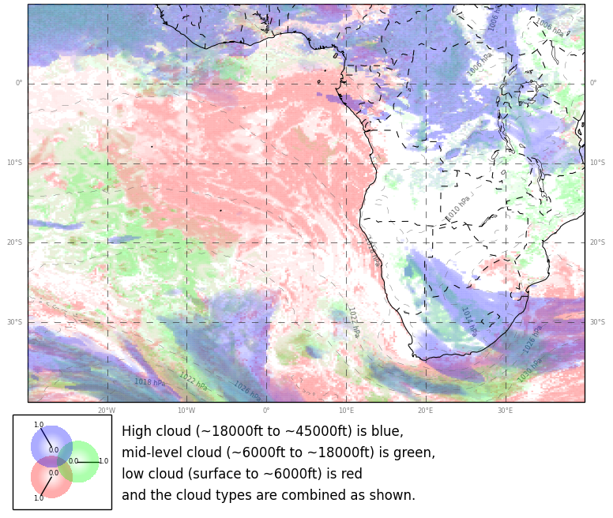
low
9/11 SUN, 12Z
high
mid

Slide 14
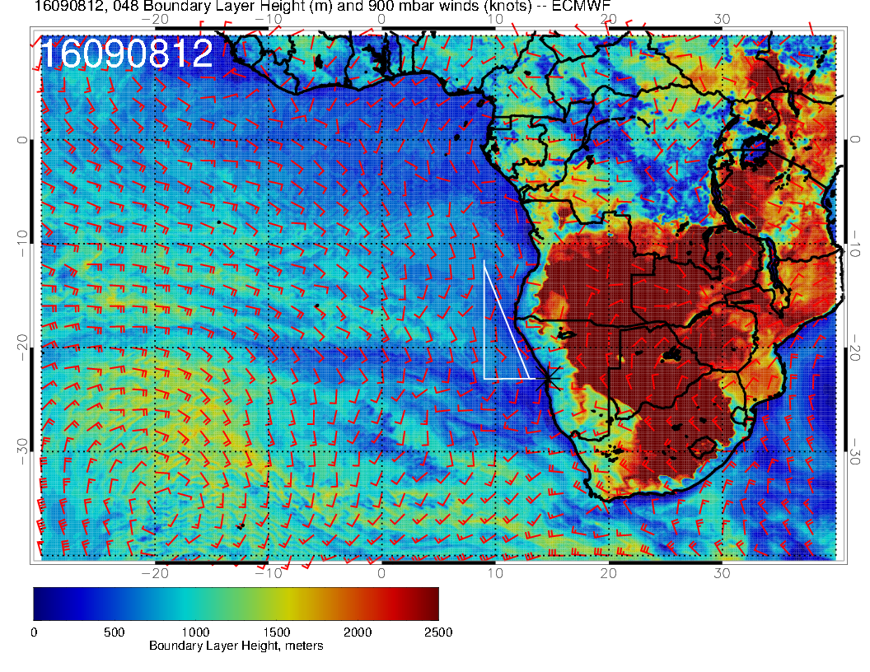
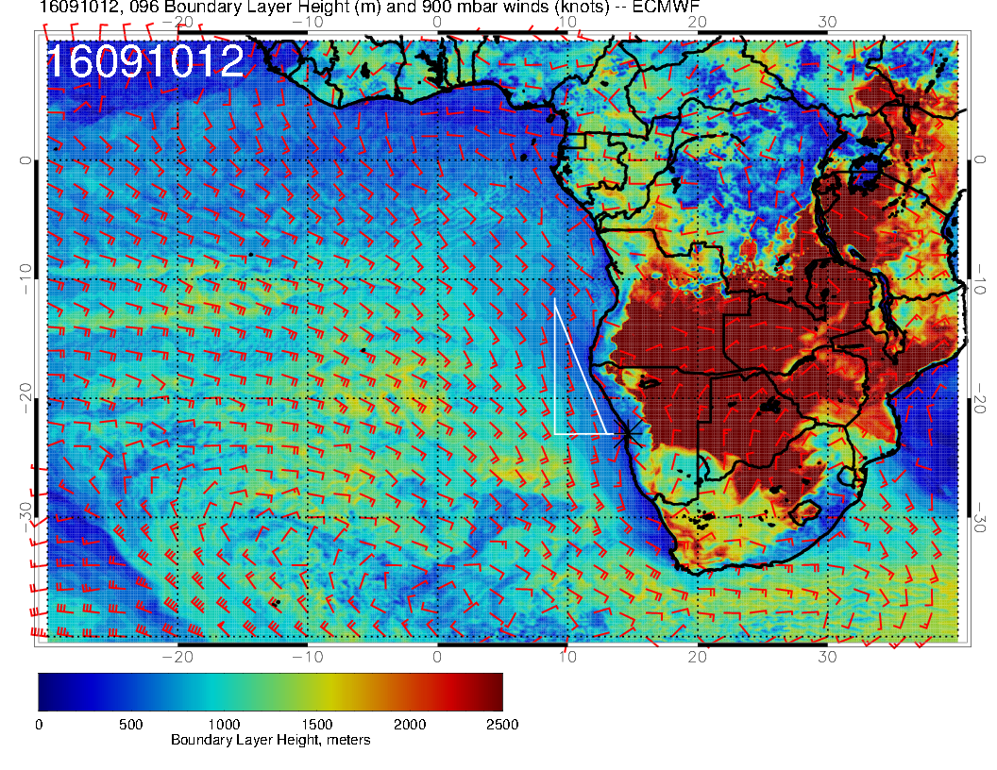
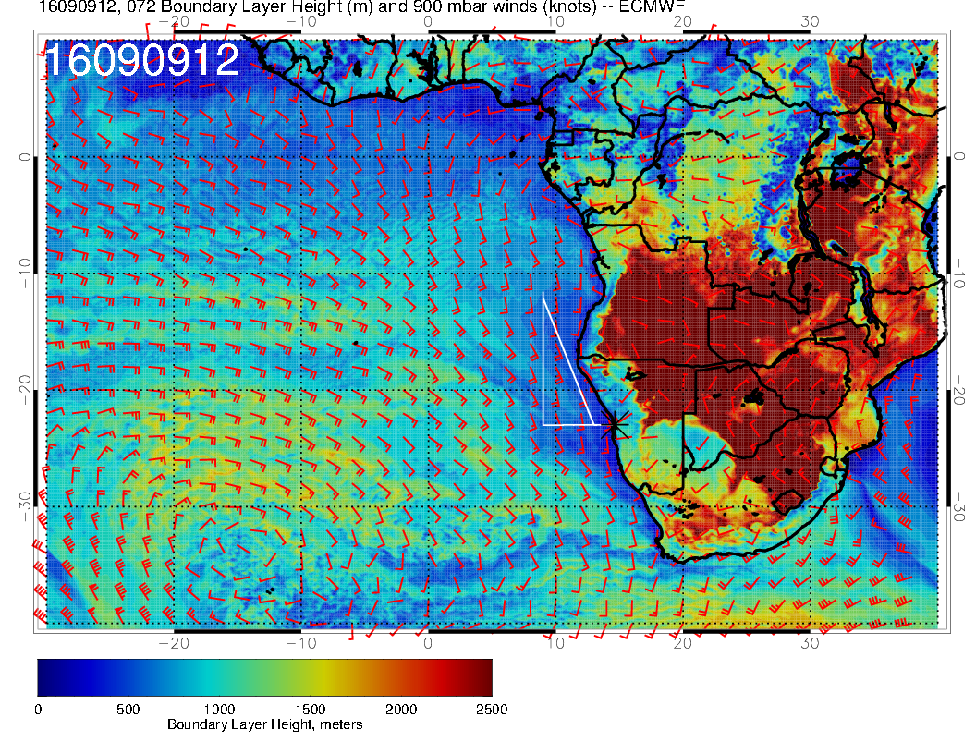
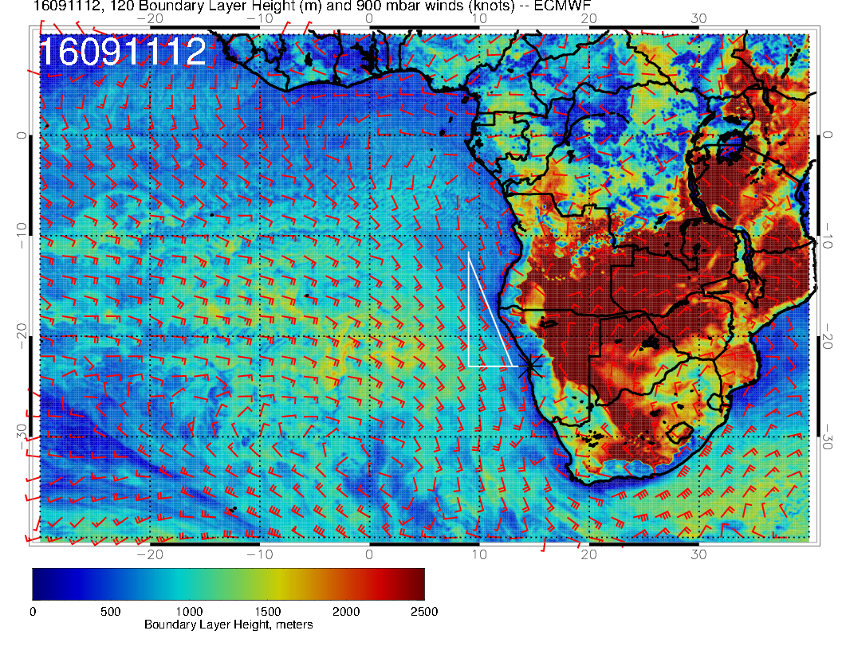
9/8 THU, 12Z
PBL
9/10 SAT, 12Z
RF
OF
9/9 FRI, 12Z
9/11 SUN, 12Z

Slide 15
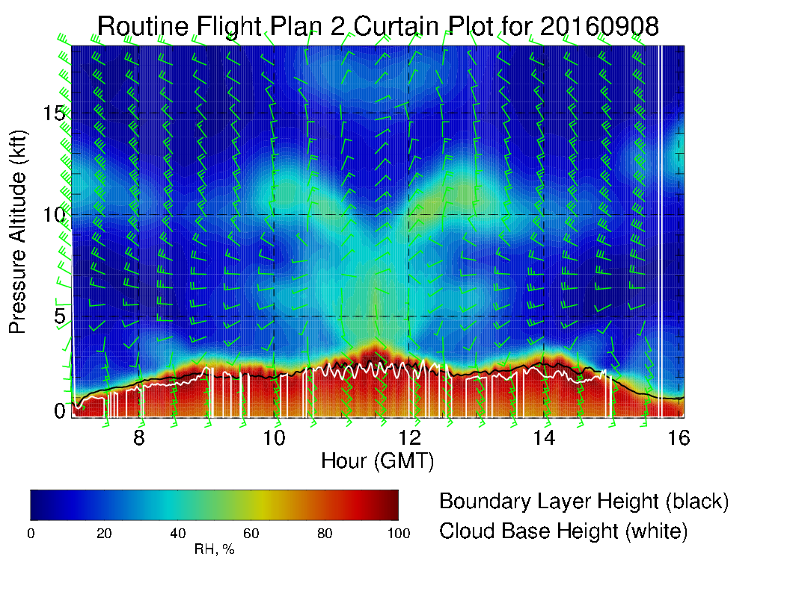
9/8 THU, 12Z
RF

Slide 16
Summary Thursday Routine Flight
Cirrus possibly to cover the first (1/3) of the flight path.
No mid level clouds
Possible opening of the Sc deck at the second half of the flight track, closing in the afternoon.
Increasing cloud base (& PBL) height along the RF track. 1 to 3 kft.

Slide 17
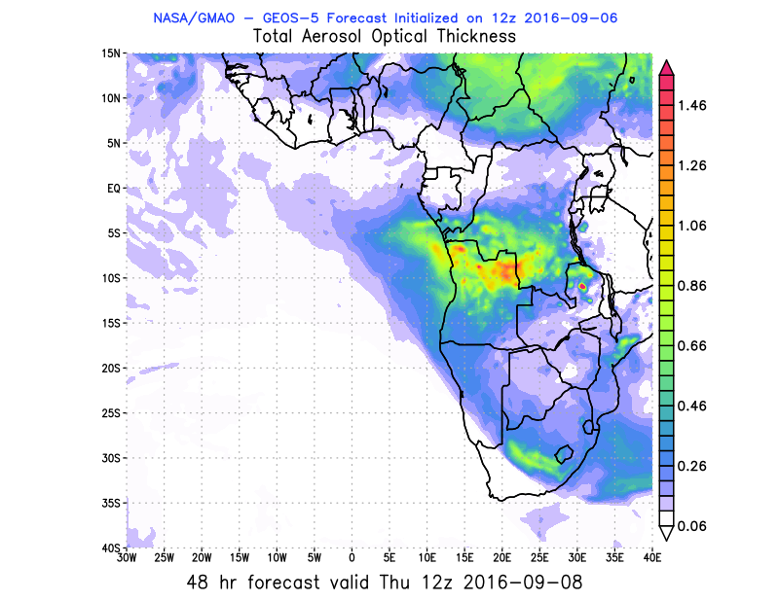
Summary Thursday

Slide 18
Summary Saturday Target Opt Flight, ER-2?
Broad patch of Cirrus over our region, but clear over the Sc field
No mid level clouds
Low cloud decks starts to be more consistent north of -20S (cold front)
PBL and Cloud base higher than on the other days, 1000 – 1500 m
70 hPa seem OK to fly the ER-2, maximum winds below 25 knots
SUNDAY: No Ci, Sc north of 20S (less ‘close’ Sc than on Saturday) 120h fc!
Saturday better day in terms of ‘Sc’ but Sun good alternative
Models diverge in 700/600 hPa winds

Slide 19
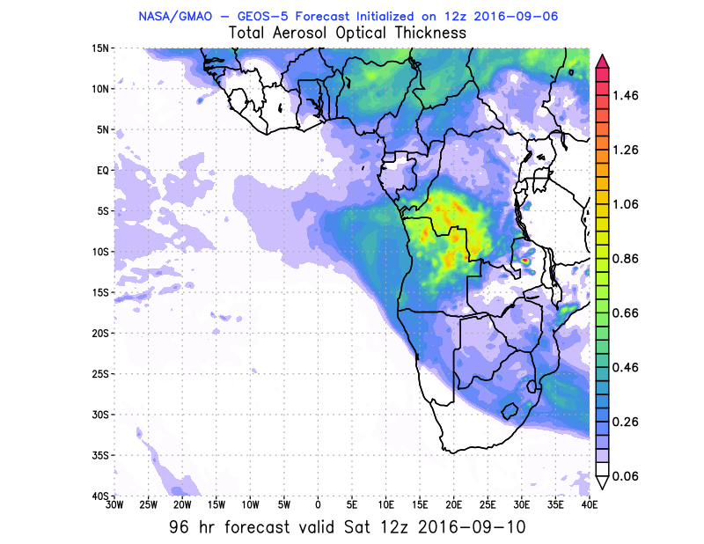
Summary Saturday

